Slide 1
Internal Assessment 1
BATHRI D - 4352

Slide 2
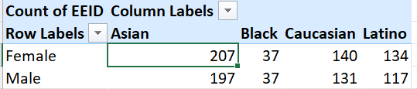
QUESTION: summary of gender and ethnicity wise distribution inside the company
STEPS:
Using pivot drag the required gender column in row table and ethnicity in column table.
Inference:
We can infer that the company has majority of Asians and has more female employees.

Slide 3
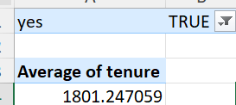
QUESTION: Average of tenure for those who left the company
STEPS:
Find the tenure of each employee
And using pivot filter those who left and find the average of tenure
Inference:
Employee works in this company on an average of 5 years.

Slide 4
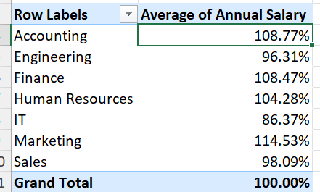
QUESTION: Is there a significant difference in average salary between departments
STEPS:
Use pivot table to find the average salary for each department and use value field settings to % of row total to see % distribution i.e if salary is above average salary or below average salary across all departments.
Inference:
We can infer that there is significant difference in avg salary across department, as marketing getting the highest above average and IT department getting 13.63% less than average salary

Slide 5
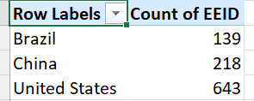
QUESTION: which country has the highest employees
STEPS:
Use pivot table to find the count of employees for each country.
Inference:
We can see that more than 60% of the company’s employees are from USA.

Slide 6
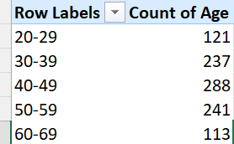
QUESTION: most common age group among employees
STEPS:
Group the age in the pivot table with a step value of 10. Use the count of age field in the value.
Inference:
The company has most employees in the age group of 40-50.

Slide 7

QUESTION: Average bonus percentage of employees
STEPS:
Get the bonus % in value and change it to average of bonus.
Inference:
We can see that the average bonus percentage is 9% approximately.

Slide 8
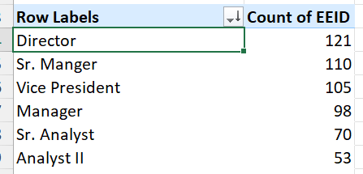
QUESTION: which job title occurs most in the dataset.
STEPS:
Get the job title in row field and count of employees in the value field.
Now sort the pivot table in descending order of the count of employees.
Inference:
Out of 1000 employees in the company there are 121 employees designated as Director which is the most repeating job title in the company

Slide 9
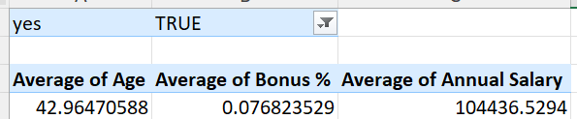
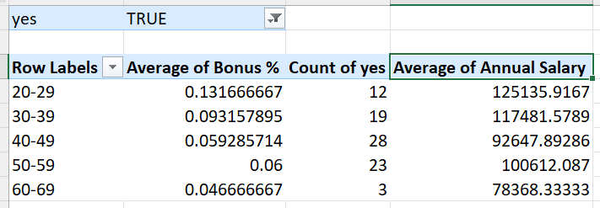
QUESTION: Primary reason for employee exit
STEPS:
Get the average bonus% and average salary for those have left and those who haven’t.
Inference:
We could see that the average bonus % for employees in the age group of 40-50 is low where the company has maximum amount of employees in the age category.

Slide 10
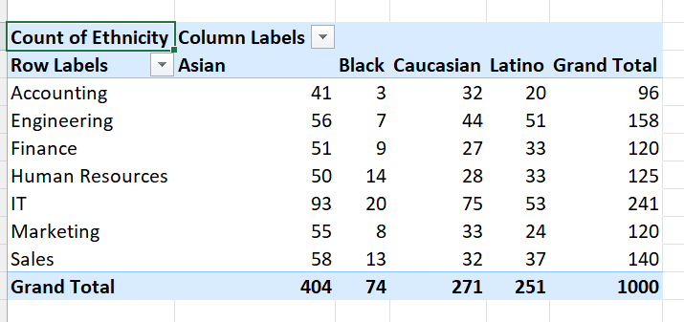
QUESTION: Does certain diversity has more representation in a department
STEPS:
Use pivot table
Inference:
Yes ,more Asians work in IT department by a big margin.

